Slide 1
CEREBRAL haemorrhages
Dr. SALINI CHANDRAN
DEPT.OF FMT, SKHMC

Slide 2
meninges and their relationship to the skull and brain

Slide 3
EPIDURAL HAEMorrhage
It is a collection of blood between the potential space that exists between the inner table of skull and the dura (periosteal layer)
Mostly traumatic in origin and Unilateral
Extension of hematoma usually is limited by the suture lines owing to the light attachment of the dura at these locations

Slide 4
EPIDURAL HAEMorrhage
Common in young adults (20- 40)
Rare in children below 2 years of age
Infrequent in elderly

Slide 5
EPIDURAL HAEMorrhage
The haematoma arises from injury to the middle meningeal artery
from the middle meningeal vein
and from diploic veins or torn dural venous sinus

Slide 6
EPIDURAL HAEMorrhage
The temperoparietal region and middle meningeal artery are most commonly involved
Anterior ethmoidal arteries may be involved in frontal injuries
the transverse or sigmoid sinus in occipital injuries
and superior sagittal sinus in trauma to the vertex

Slide 7
EPIDURAL HAEMorrhage
Lucid interval
Blunt trauma/ a blow to the head, followed by: – 1) Initial confusion, decreased consciousness, or loss of consciousness
A “lucid interval” a brief period of full consciousness/restored mental status. The patient seems back to his/her “normal self.”
the patient becomes confused, somnolent (sleepy), may have neurologic signs such as hemiparesis, one dilated pupil, may become comatose.

Slide 8
EPIDURAL HAEMorrhage
Circumscribed ovoid or disk shaped blood clot
Mydriasis on the side of the haematoma
Diagnosis – CT biconvex lenticular shaped haemorrhage

Slide 10
subDURAL HAEMorrhage
A subdural haematoma (SDH) is a collection of blood that forms in the subdural space, the space between the dura mater and the arachnoid mater
They can be classified as acute (< 3 days after injury), subacute (3-21 days), or chronic SDH (>21 days)
Commonest cause- Acceleration deceleration injury

Slide 11
subDURAL HAEMorrhage
Bleeding in a SDH occurs from tearing of the bridging veins that cross from the cortex to the dural venous sinuses,
The majority of acute SDH occur due to trauma
Haematoma often not associated with fracture of skull
Common in elderly and alcoholics

Slide 12
subDURAL HAEMorrhage
Commonly seen over upper lateral surface of cerebral hemispheres more commonly over frontotemporal region
Acute –rupture of large bridging veins or cortical artery or laceration

Slide 14
subDURAL HAEMorrha
Drowsy or comatose
Unilateral headache
Hemiparesis
Enlarged pupil on same side
Focal neurological deficits

Slide 15
Subacute
Rupture of small bridging veins
Associated with minor cerebral contusions or swellings
Clinical –Drowsiness. headache, confusion, forgetfulness, or mild hemiparesis

Slide 16
CHRONIC SDH (pachymeningitis haemorrrhagica
Alteration in mental state
Progressive focal neurological states
(headache,cognitive decline, gait abnormalities. and hemiparesis)

Slide 18
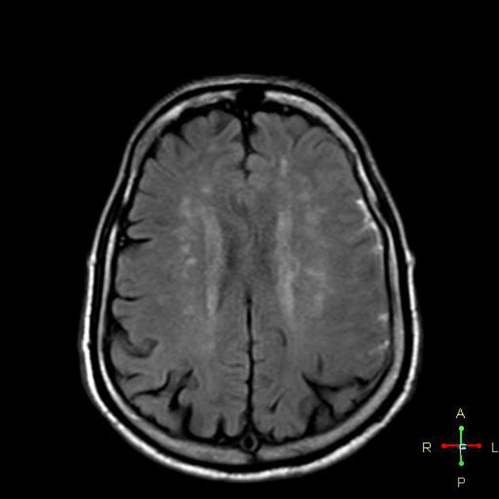

Slide 19
SUBARACHNOID HAEMORRHage
Subarachnoid hemorrhage (SAH) the presence of bleeding within the subarachnoid space.(Between Arachnoid and Pia)
Mixed with CSF and distributed over the surface of brain
Mostly venous in origin
Cerebral arteries and veins
Haematoma formation is extremely rare

Slide 20
SUBARACHNOID HAEMORRHage
Said to be the commonest lesion following intracranial Injury
Unilateral or Bilateral
Localised or Diffuse
Blood is removed by phagocytosis
“Plaques jaunes” – Yellowish brown areas of discolouration of arachnoid which are left behind about one month after the injury

